Slide 1
Project Scheduling
1

Slide 2
About Project Scheduling
Project scheduling is a responsible activity of the project manager.
A project schedule is a mechanism that is used to communicate and know which tasks are needed and must be performed in a project.
The project manager estimates the time and resources required to complete activities and organizes them into a coherent sequence.
Effective project scheduling leads to the success of the project, reduced cost, and increased customer satisfaction.
1

Slide 3
Project Scheduling Process
Identify all the functions/modules required to complete the project.
Break down large functions into small activities, i.e., develop a WBS structure.
Determine the dependency among various activities.
Allocate resources to activities.
Assign people to conduct different activities.
Plan the beginning and ending dates for different activities.
Create an activity network and bar or Gantt charts.
1

Slide 4
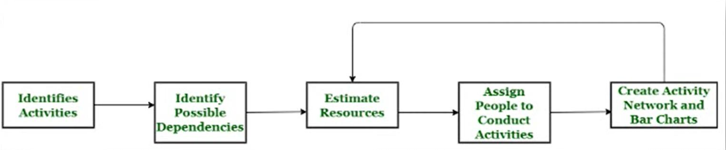
Project Scheduling Process
1

Slide 5
Basic Principles of Project Scheduling
Compartmentalization: The project is divided into a number of manageable activities and tasks.
Interdependency: Certain tasks occur in sequence, whereas other tasks occur in parallel.
Time Allocation: Each task has to be assigned a specific time period, i.e., a start date and a completion date.
Effort Validation: The project manager ensures that the allocated number of people work on a given task.
Defined Responsibilities: Each task is assigned to a specific member of the software team.
Defined Outcomes: Each task has a defined outcome, i.e., a work product.
Defined Milestones: Every task should be associated with a project milestone. A milestone is accomplished when one or more work products have been reviewed for quality.
1

Slide 6
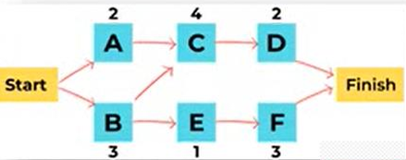
Project Scheduling Techniques
1. Critical Path Method:
It helps you determine both the longest and shortest possible time taken to complete a project.
There are three essential elements: the tasks required to complete the project, which tasks depend on the completion of others, and a time estimate for each activity
Example:
There are four tasks in the project – A, B, C, and D.
Task B and D can only begin after task A completes, whereas task C has no such restriction.
Task A will be time-sensitive, as any delay in its completion can delay tasks B and D.
Called a Critical Task.
This helps in identifying and separating the independent variables.
Finally, it adds milestones to the project.
1

Slide 7
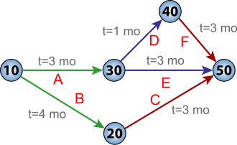
Project Scheduling Techniques (Continued)
2. Program Evaluation and Review Technique (PERT):
It is a way to schedule the flow of tasks in a project and estimate the total time taken to complete it.
PERT charts offer a visual representation of the major activities (and dependencies) in a project.
It calculates:
Optimistic time (O): Quickest time you can complete a project.
Pessimistic time (P): Longest time it will take to complete your project.
Most likely time (M): How long it will take to finish your project if there are no problems.
Formula: (O + 4M + P) / 6
1

Slide 8
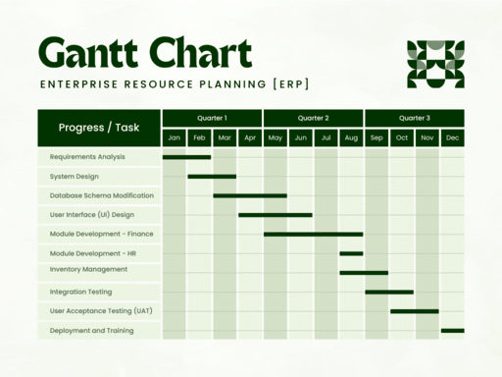
Project Scheduling Techniques (Continued)
3. Gantt Chart:
A Gantt chart is a type of bar graph that project managers use for planning and scheduling in complex projects.
It represents each task horizontally on a bar chart, showing the start and end dates; they frequently include deadlines and task dependencies.
It makes it easier to visualize the progress of a project and see how different tasks interact with one another.
1

Slide 9
Project Scheduling Techniques (Continued)
4. Task List:
One of the simplest project scheduling techniques is the creation of a task list.
Create a task list using a word processor or spreadsheet software.
It creates a list of tasks and includes important information like the task manager, start date, deadline, and completion status
1

Slide 10
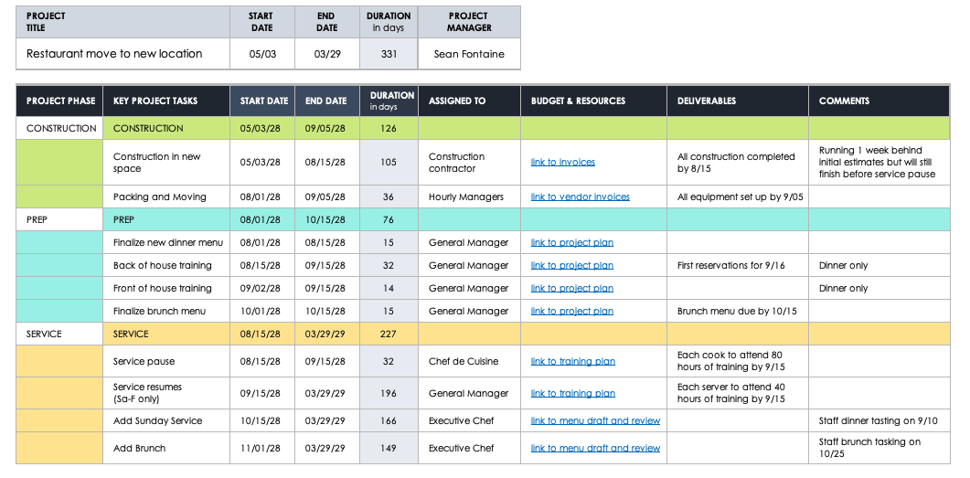
Project Scheduling Techniques (Continued)
1

Slide 11
Project Scheduling Techniques (Continued)
5. Fast Tracking:
In fast tracking, a project is implemented by either simultaneously executing many tasks or by overlapping tasks with each other.
Example: In a software development project, designing and development can be taken up in parallel. Once the design of essential features is ready and approved, the development team can work on it. Meanwhile, the designing team will work on the remaining elements and functions.
6. Crashing:
Crashing deals with involving more resources to finish the project on time.
Example: Adding more developers to a project or paying overtime to employees.
Crashing can only be applied when it fits your project budget.
1

Slide 12
Project Management Spectrum
1

Slide 13
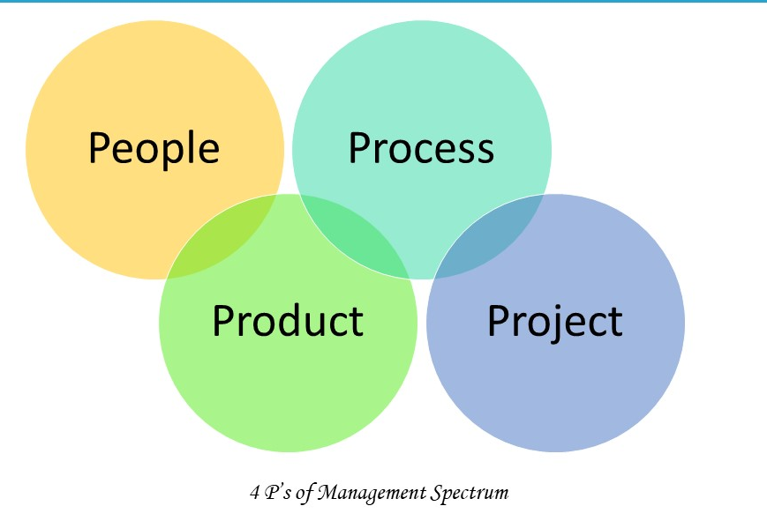
The Management Spectrum
In software engineering, the management spectrum describes the management of a software project.
For properly building a product, there’s a very important concept handle by Project Manager.
These components play a very important role in your project that can help your team meet its goals and objective.
Effective software project management focuses on the four P’s:
People
Product
Process
Project
1

Slide 14
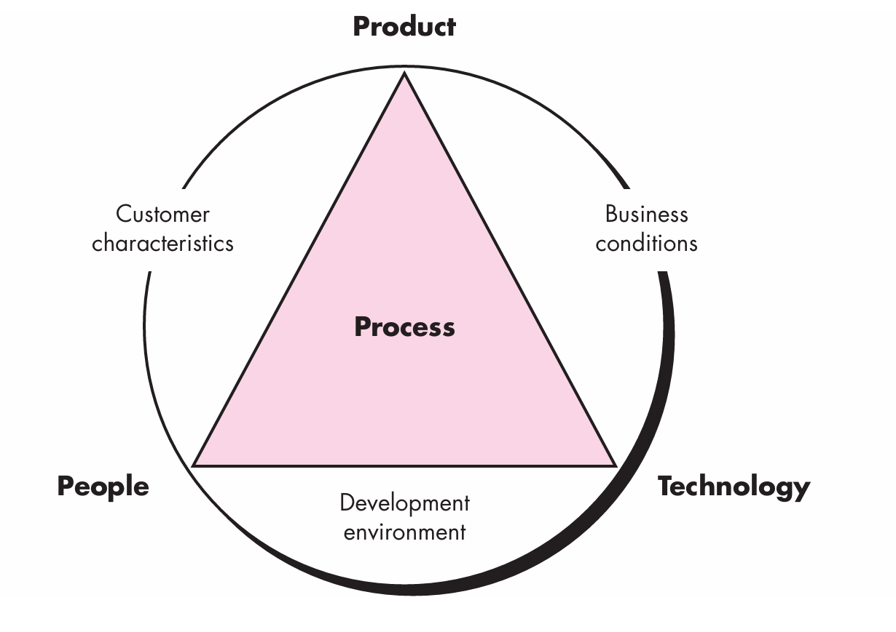
The Management Spectrum
1

Slide 15
People
The most important contribution in software project is not made by system or tool, It is done by people. i.e. Human Resources.
The success of project depend on selecting right kind of people with right talent.
Depending on there roles & responsibilities, following are the main categories:
Senior Manager: Define the business issues & have significant influence on the project.
Project Manager: Plan, Motivate, Organize & Control the project work. Has problem solving skills & manageable team abilities.
Software Engineer: Who deliver technical skills which are necessary in project.
Customer: Who specify the requirement for the software project.
End Users: Who interact with the software product
1

Slide 16
Product
The product is the ultimate goal of the project.
This is any types of software product that has to be developed or deliverable.
Before a product can be planned, its objectives and scope should be established, alternate solutions should also be considered & technical & management constraints should be identified.
Lack of these information, it is impossible to define reasonable and accurate estimation of the cost, identify possible risk & define manageable project schedule.
1

Slide 17
Process
Project managers and team members should have a methodology and plan that complete project as per customer requirements.
Without a clearly defined process, team members will not know what to do and when to carry out project activities.
Using the right process will increase the project execution success rate that meets its original goals and objectives.
The Process has several steps involved like, Documentation phase, Designing phase, Implementation phase, software configuration management, Deployment phase and Interaction phase.
1

Slide 18
Project
The project is the complete software project that includes requirement analysis, development, delivery, maintenance and updates.
The project manager plays a critical role for completing project.
They are responsible to guide the team members to achieve the project’s target and objectives.
They helping & assisting them with issues, checking on cost and budget and making sure that the project stays on track with the given deadlines.
They manage complete project activities to avoid project failure
1

Slide 19
About W5HH Principle
Barry Boehm provided philosophy that prepares easy and manageable designs for software projects.
The W5HH questions help project managers to guide objectives, timelines, responsibilities, management styles, technical approaches and resources in project.
These method used for efficient software project management & development
1

Slide 20
About W5HH Principle
Barry Boehm provided philosophy that prepares easy and manageable designs for software projects.
The W5HH questions help project managers to guide objectives, timelines, responsibilities, management styles, technical approaches and resources in project.
These method used for efficient software project management & development.
W5HH Questions:
Why?
What?
When?
Who?
Where?
How?
How Much?
1

Slide 21
About W5HH Principle
Why the system is going to be developed?
This focus on the business reasons & problem statements for developing the software.
Identify whether the project’s purpose will justify the cost, time spent on it by people?
What is activities are needed to be done in this?
It help team to establish project schedule by identifying key project tasks that are required by the customer.
It mentioned guidelines & principle for determining tasks that need to be complete.
When will it be completed?
When project tasks will be started and when they enter into the final stage to reach the goal.
1

Slide 22
About W5HH Principle
Who is responsible for each activities?
The role and responsibility of each member of the software team are defined.
Where are they organizationally located?
Not all roles and responsibilities reside within the software team itself.
The customer, users and other stakeholders also have responsibilities.
How will the job be done technically and managerially?
Once the product scope is established, management and technical strategy for the project must be defined.
How much of each resource is needed?
It figure out how much resources necessary to complete the project as per customer requirement & budget of the project.
1

